Slide 1
Exponential Moving Average
Sreekar

Slide 2
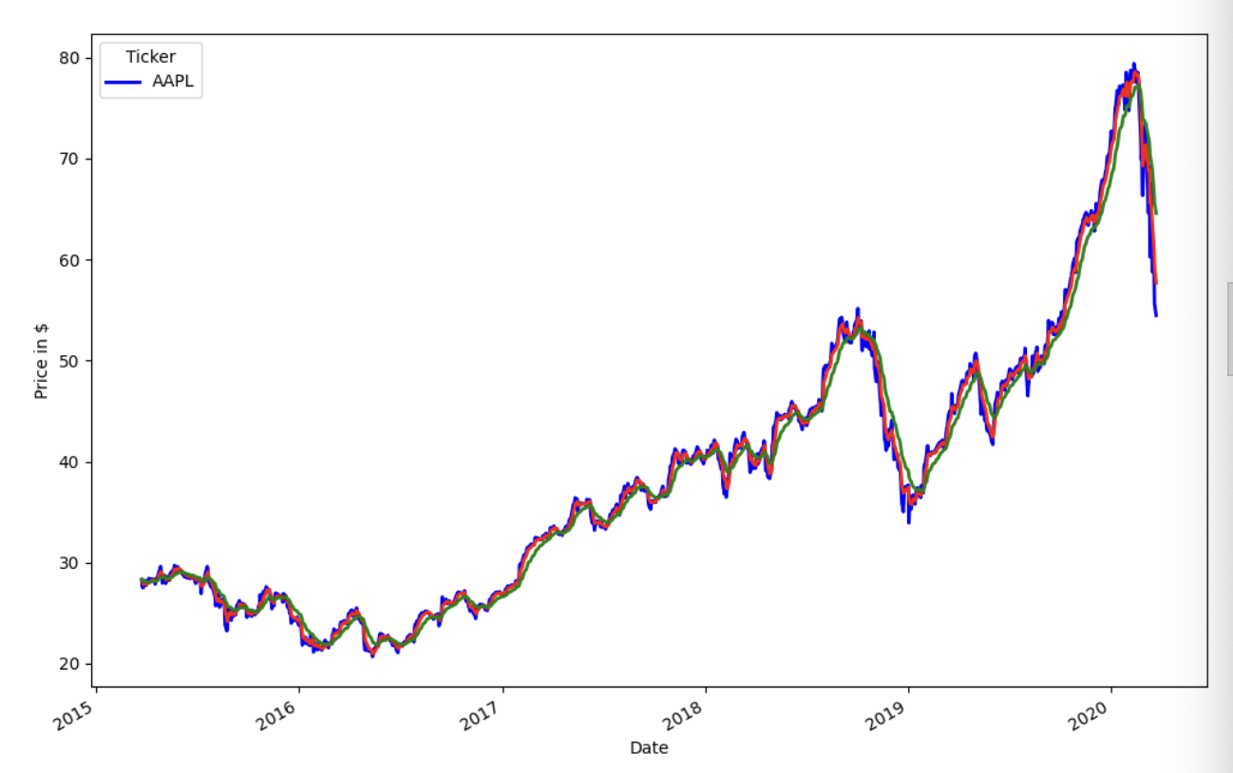
Methodology
Calculate EMA for 20 day and 5 day ranges
When shortEMA > longEMA, there’s bullish growth, so we buy
When shortEMA < longEMA, there’s bearish growth, so we sell

Slide 3
Pros and Cons
Pros
Weighs recent prices more, so adapts quickly to market changes
Filters out minor fluctuations, focusing on sustained trends
Cons
In strong trending markets, a simple buy & hold might capture more gains.
In choppy or low-volatility conditions, the strategy may produce whipsaws

Slide 4
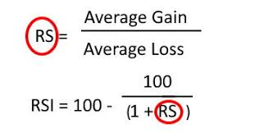
Adding RSI
Added the Relative Strength Index (RSI) as an additional momentum indicator alongside EMA crossovers
Helps confirm the strength of the trend—only signals a buy when RSI is above 50 (bullish momentum) and a sell when below 50 (bearish momentum), which reduces false signals and improves decision making - tried to

Slide 5
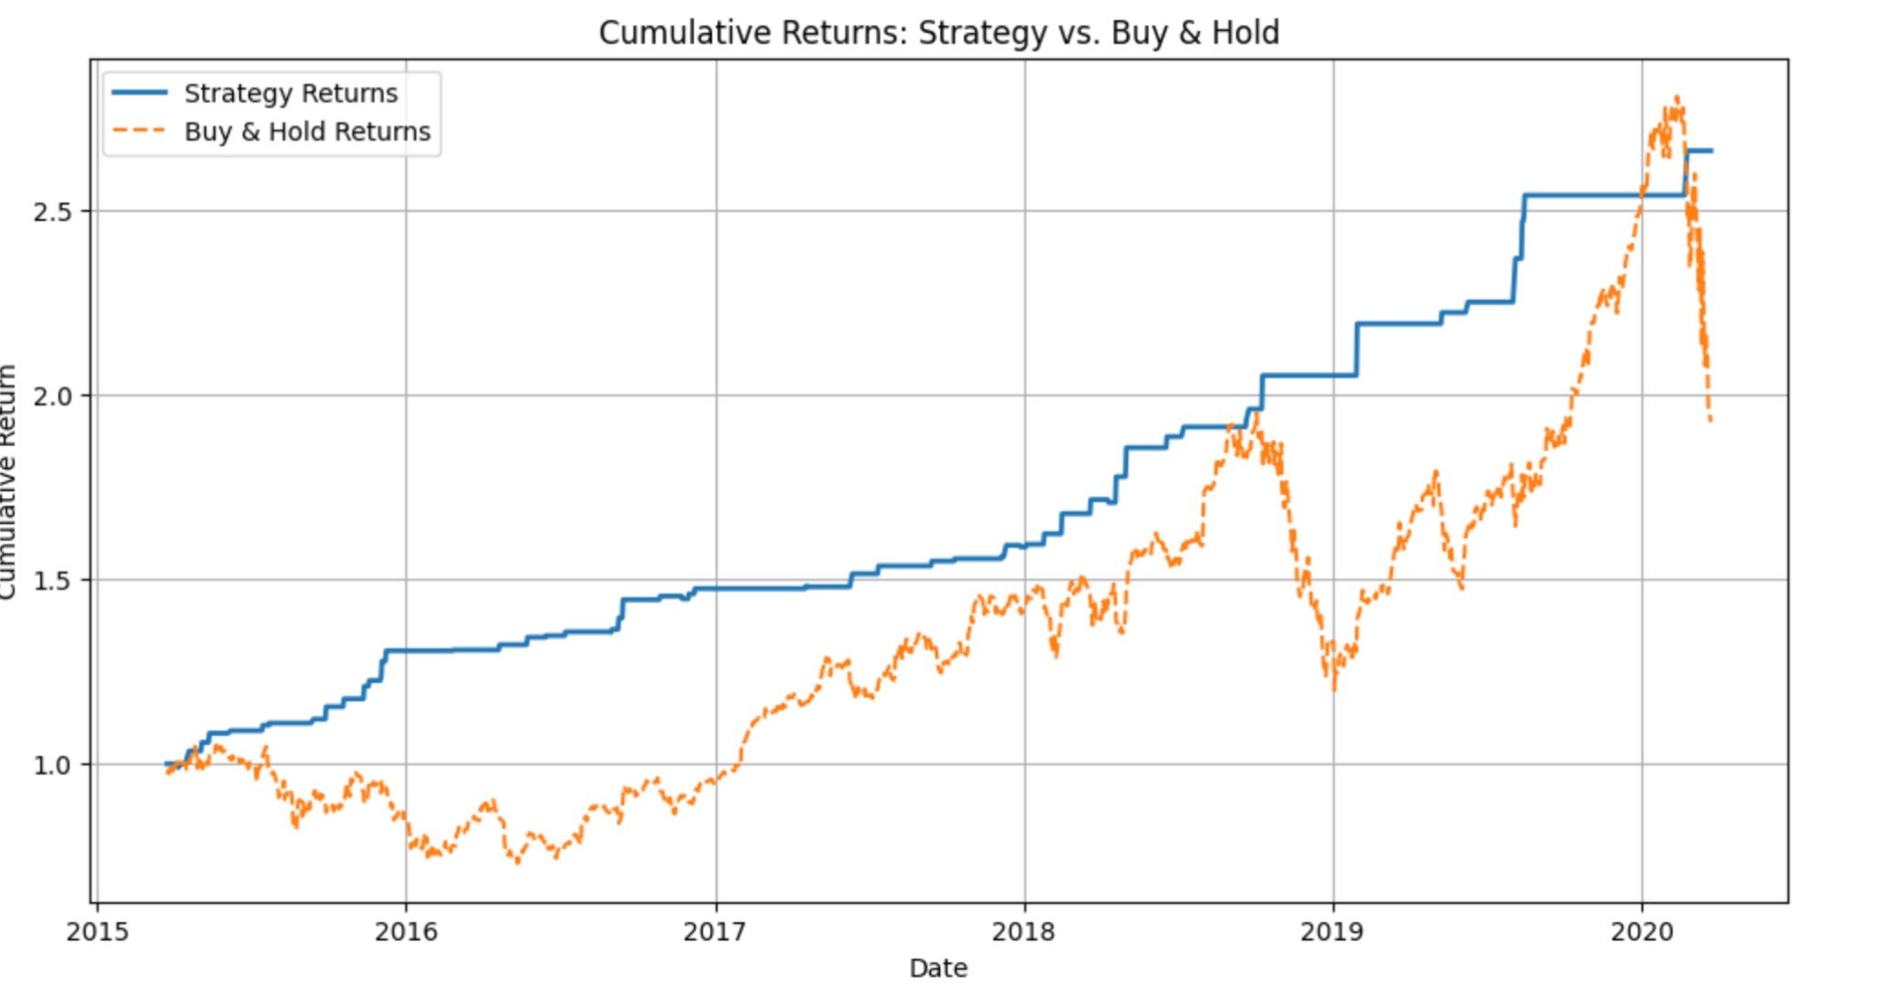
Result
2.659082 - Strategy return
1.924474 - Buy & Hold return

